Slide 1
Scrapegoat
Stop Coding, Start Herding
Herd!
Notes:
Lucas

Slide 2
01
Introduction
Notes:
Lucas

Slide 3
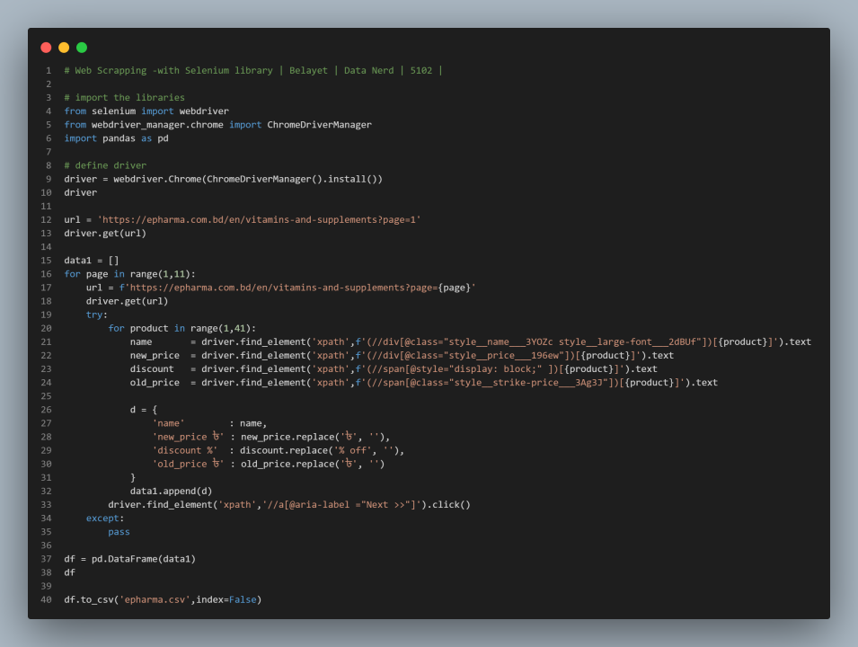
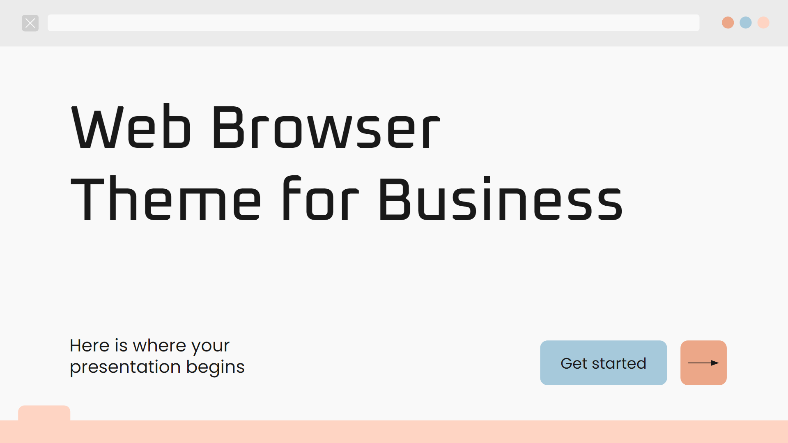
Scraping
Is
Hard
Notes:
Lucas

Slide 4
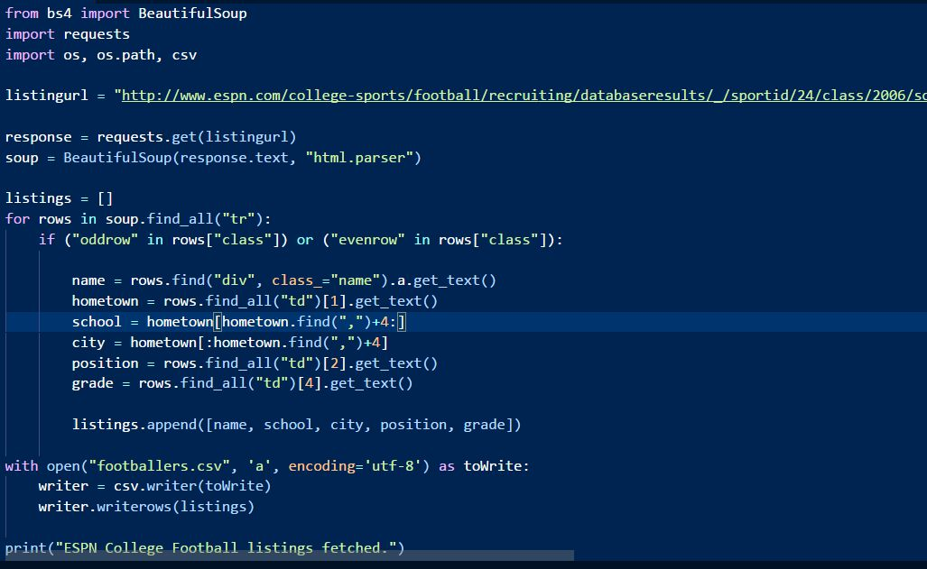
Scraping
Is
Hard
Notes:
Lucas

Slide 5
The Problem
Complexity
Scrapers can be very complex and require a lot of code.
No Reusability
Almost none of the code written in a scraper can be reused.
Web Scraping
Fragility
Any website updates can potentially break a scraper.
Exporting
Packages often do not support exporting to major file types.
Notes:
Lucas

Slide 6
What if websites could be queried just like databases?
Notes:
Lucas

Slide 7
The Solution
Simplicity
Build an easy query language with a simplistic command suite for developers.
Reusability
Design for common scrape design patterns developers might use.
Robustness
Favor scraping on logic rather than rigid commands (xpath).
Exporting
Built in saving to common data file types.
Notes:
Nathan
To solve the problems of modern web scraping, we would need a way to meet these requirements.
Simplicity in query building, so users aren’t immediately overwhelmed by technical jargon or terminology.
Reusability of code, so only minimal changes are needed from website to website.
Robustness to website changes, avoiding reliance on rigid paths.
And finally, the ability to export data to common file types.

Slide 8
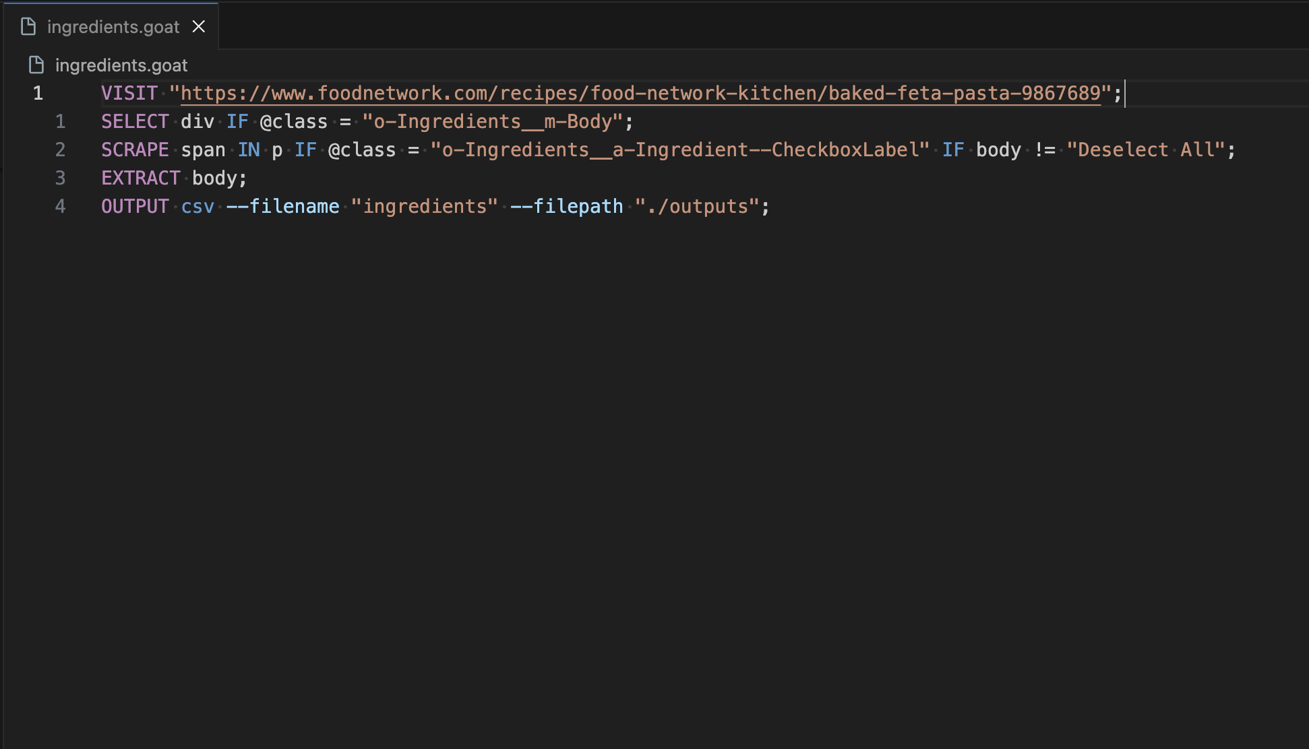
Introducing Scrapegoat
+
Goatspeak
Notes:
Lucas

Slide 9
Scrapegoat Solution
Goatspeak QL
API Layer
Web Application
Easy to use
SQL-like syntax
Simple and flexible
Interpret queries
Reusable scraping
Expose functionality
User management
Accessible
Intuitive visuals
Wrap functionality
Notes:
Nathan
Consists of three overarching elements.
Custom query language, built for ease of use.. simple to use but is flexible enough to generate complex queries.
The API layer, which combines a Python SDK and accessible endpoint.

Slide 10
02
Demo
Notes:
Arman + Kate

Slide 11
03
Development Process
Notes:
Kate

Slide 12
Development Timeline
SDK
Loom
Backend
Frontend
LSP
Week 1
Week 2
Week 3
Week 4
Week 5
Week 6
Week 7
Week 8
Notes:
Kate
We dedicated our time to 5 parts of the project
How we distributed our work over the weeks of the project, not including midterm week

Slide 13
Technical Solutions
SDK + CLI
Loom
Backend
Frontend
LSP
Converts Goatspeak language into executables through an interpreter. Runs them iteratively like a SQL command.
Leveraged textual to build a terminal visualization of the DOM, allowing users to build .goat files.
Implemented the scrapegoat sdk with user data management and exposed functionality through HTTP endpoints
Created visual workflow for building queries using a DOM tree, and saving them to a profile.
Implemented syntax highlighting and intellisense using vscode language extension sdk for .goat support
Notes:
Kate
SDK + CLI - takes in Goatspeak commands, language similar to SQL, and runs them iteratively to scrape sites. built in vanilla python
Loom - help user build their .goat files through a terminal visualization. also built in textual python
Backend - handles the SDK, user data management and HTTP endpoints for the front end. built in fast api python
Frontend - web app for users to visual DOM tree, build and save configs, and scrape using those configs. built in react
LSP - vscode extension to help support .goat files. built in typescript/javascript

Slide 14
Challenges
Unfamiliarity
Parallel Development
Scheduling
Having never developed python packages, programming languages nor LSPs (language servers), we had to allocate time to learning before development could proceed.
While building scrapegoat, teams were relying on pieces of code from the SDK that was yet to be created, causing bottlenecks across development.
As a multiset team, the time we had to work together was limited. Communication was also very difficult, and primarily occurred online.
Notes:
Kate

Slide 15
Lessons Learned
Read Documentation
Create Initial Designs
Communicate
Researching available solutions and reading official documentation.
Conforming provided examples to our use cases.
Using interfaces to define the contract between the different layers of the system so developers could work in parallel more efficiently.
Maintaining constant virtual communication.
Defining consistent meeting times that work for everyone.
Notes:
Quinn

Slide 16
Future Improvements
CRON Jobs
Web Representation
Although we had the idea of being able to set automatic scraping jobs using specific configs, it ended up being out of scope for this term.
We initially had hoped to render the target website into the scrapegoat website, with hover and overlay features, allowing users to avoid using the browser inspect tools. This functionality would require complex DOM rebuilding which is out of the scope of the term.
Notes:
Quinn

Slide 17
How can you use Scrapegoat?
Core
> pip install scrapegoat-core
Loom
> pip install scrapegoat-loom
CLI
> scrapegoat -h
LSP
*Goatspeak extension available December 2nd
Docs
*Documentation available December 2nd
Notes:
Arman

Slide 18
Thank You!
Do you have any questions?

